Slide 1
2025 Offseason Mechanical Seminar
Seminar 1 – Engines and Motors
Authored By: John Thibert
Latest Revision: 05/20/2025

Slide 2
Revision Table
Date (MM/DD/YYYY) | Description
05/20/2025 | Release

Slide 3
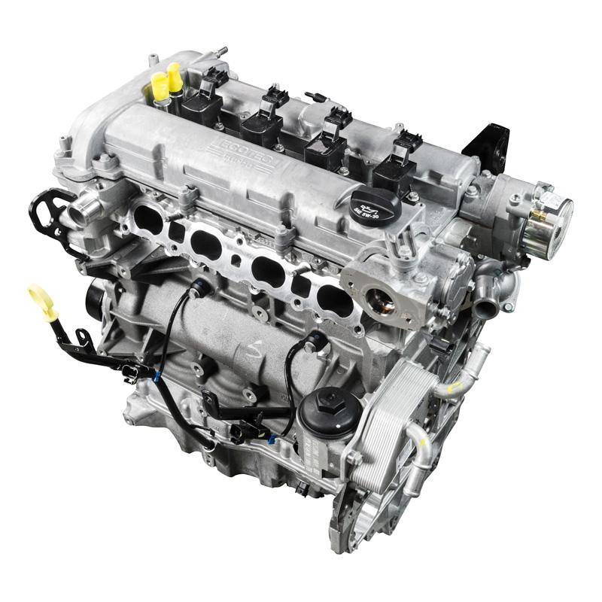
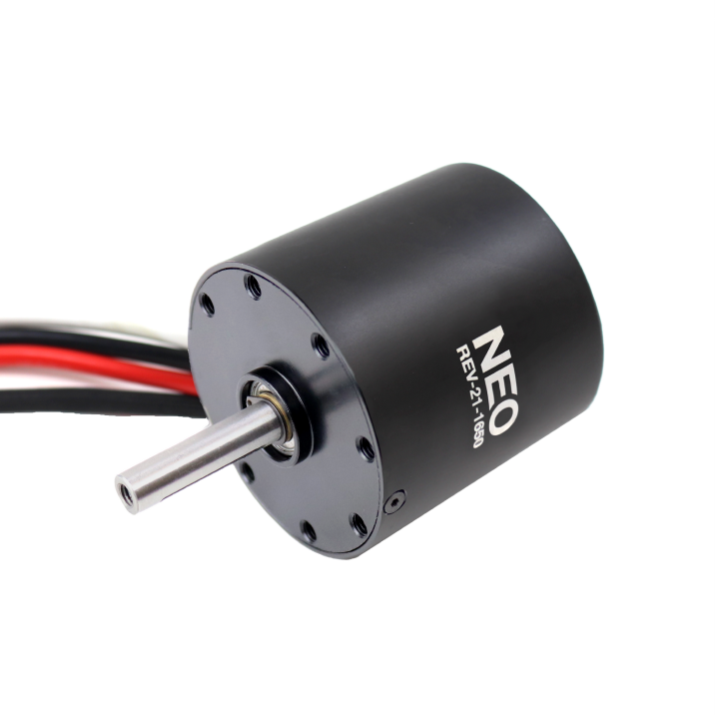
Engines vs Motors
Engines convert CHEMICAL energy into mechanical energy
Motors convert ELECTRICAL energy into mechanical energy

Slide 4
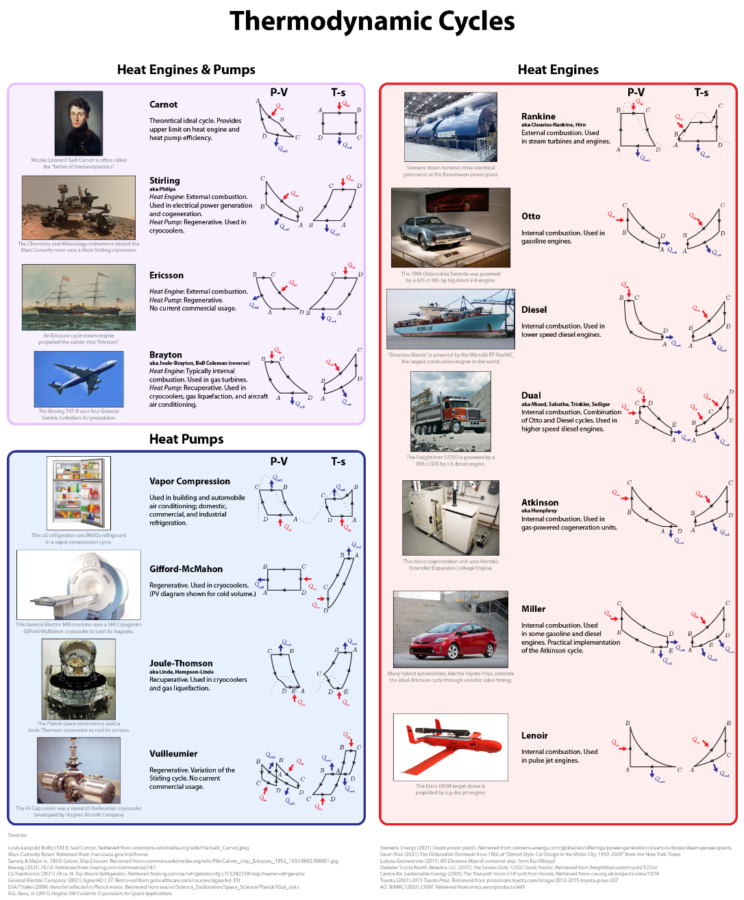
Engine Types
Typically named after their thermodynamic cycle
Different use cases, efficiencies, and practicalities
Some can even be a hybrid of two different cycles
Well focus on one: Otto cycle

Slide 5
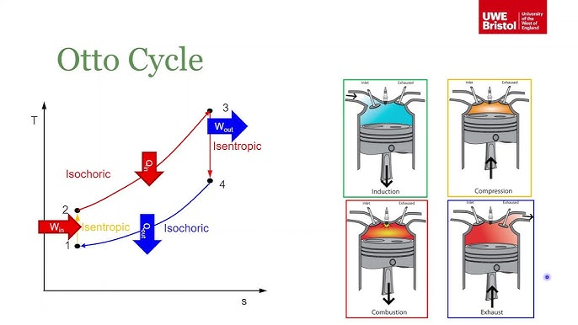
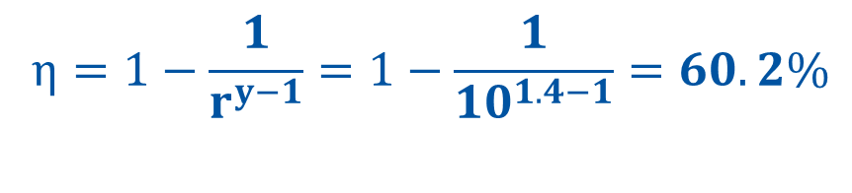
The Otto Cycle
Typically cover all gasoline car engines
4 stroke & 2 stroke engines
Typical efficiencies are in the realm of 30-40% efficient
$$η=1−\frac{1}{r^{y−1}}=1−\frac{1}{{10}^{1.4−1}}=60.2\%$$
​
Isentropic: A process where no heat is added or lost and everything happens in a perfectly efficient way, like an ideal, lossless compression or expansion of gas.
Isochoric: A process where the volume stays the same, so the gas is heated or cooled without changing its size.
η = thermal efficiency (ideal)
r= compression ratio (typically between 8:1 and 12:1 for modern gasoline engines)
𝛾 = specific heat ratio (typically ~1.4 for air)
Theoretical max

Slide 6
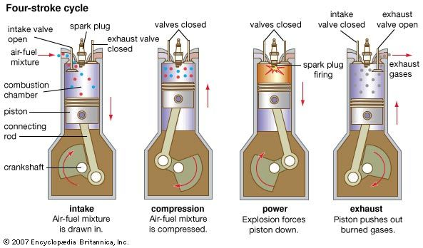
Deeper Dive into 4 Stroke Car Engines
Engines have 6 main systems:
Cooling system
Radiator, heater, fans, etc
Fueling system
Fuel pump, injectors, etc
Ignition system
Ignition coils, spark plugs, etc
Lubrication system
Oil pump, bearings, etc
Intake/Exhaust system
Turbochargers, superchargers, manifolds, etc
Mechanical system
Pistons, connecting rods, valves, camshafts, actuators

Slide 7
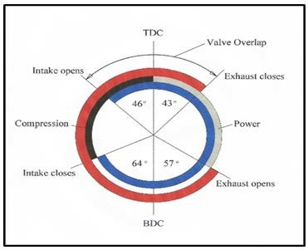
Engine Timing
Involves both ignition timing, and valvetrain timing
Camshafts spin at half the crankshaft speed
Extremely important, especially in modern engines where clearances are small

Slide 8
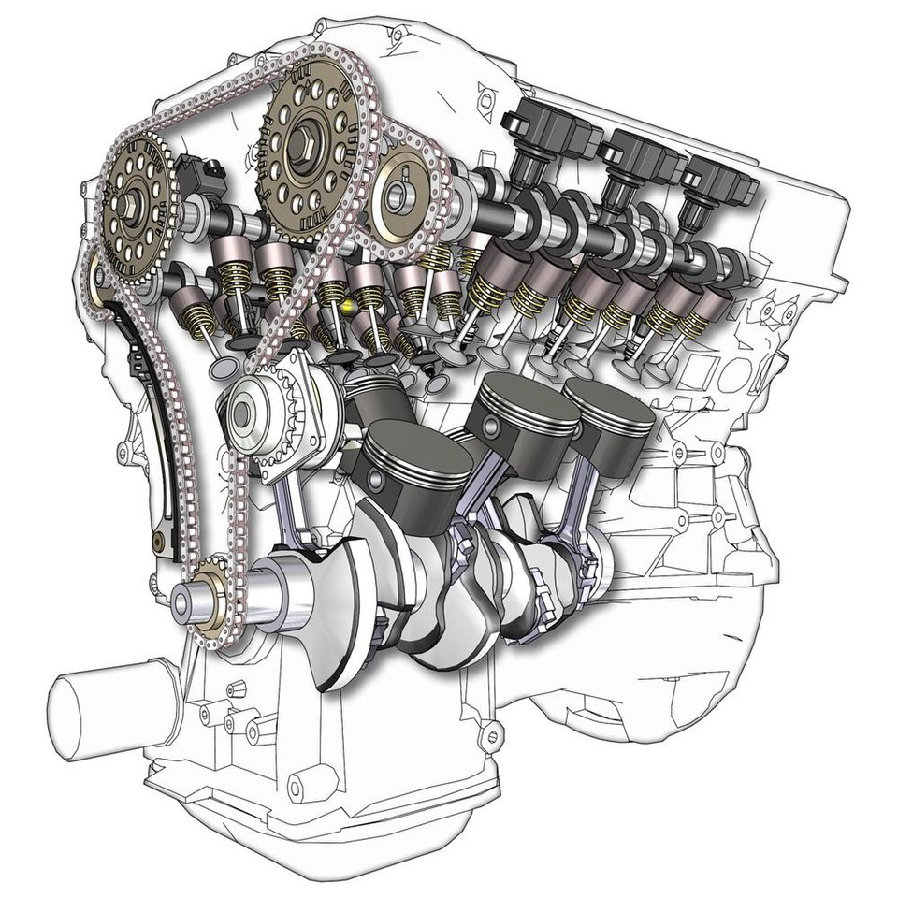
Engine Cutaway

Slide 9
Electric Motor Types
All electric motors operate in one main way:
Use electricity to generate magnetic fields
Magnetic fields create forces that cause motion
However, the ways that motors accomplish this vary greatly
Three main architectures:
Stepper
Brushed
Brushed DC motors – The CIM, miniCIM, 775, fall under this category
Brushless
Permanent Magnet Synchronous (PMSM) – The NEO, falcon, kraken, fall under this category
Induction Asynchronous (AM)
Switched Reluctance (SRM)
Hybrids exist between these types

Slide 10
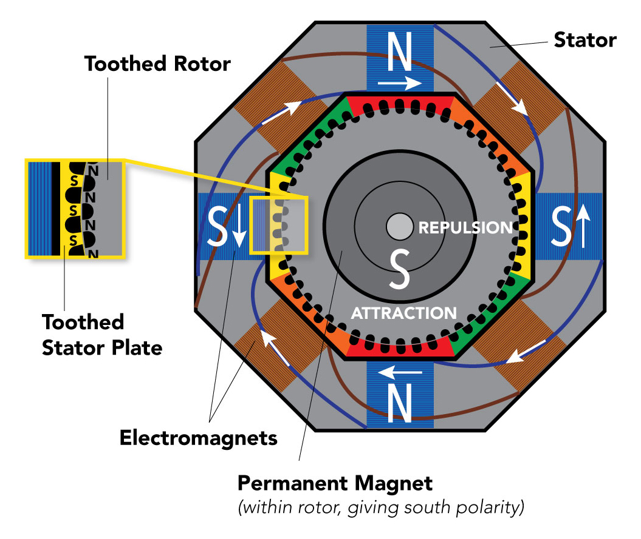
Stepper Motors
These motors step incrementally by a certain number of degrees (a common amount is 1.8°)
Extremely high holding torque
Good for holding positions and moving set amounts without the use of encoders
Require special stepper drivers
Typically draw a lot of power
Typically, low speed, high precision

Slide 11
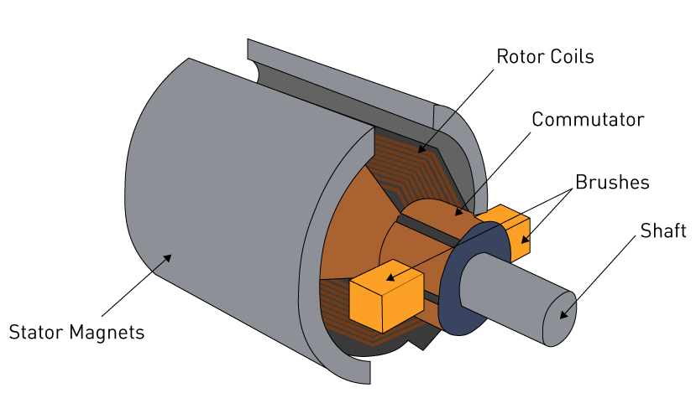
Brushed Motors
Easy to drive (just connect power)
Simple operating principle
Lower starting torque than brushless
Typically lower power density than brushless motors
Brushes can wear out over time
No sensors or other electronics required to drive
FRC example: CIM, miniCIM, 775 Pro

Slide 12
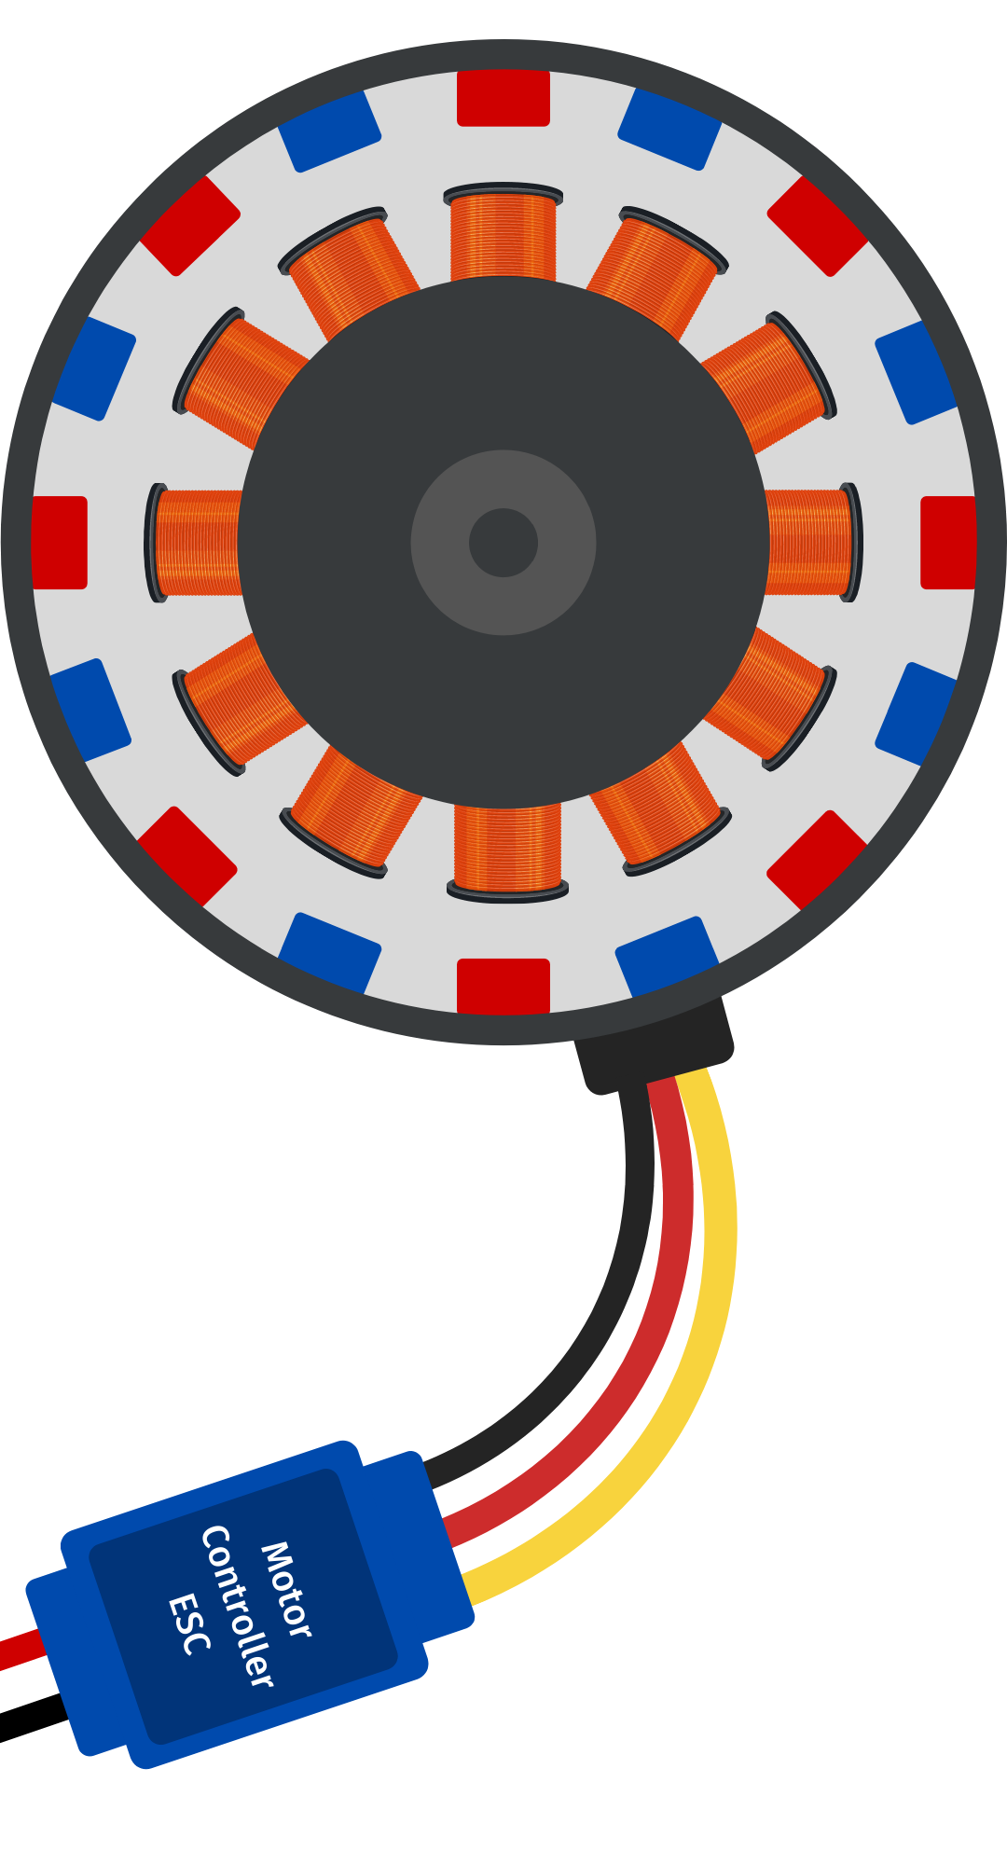
Brushless Motors
Rotor
Typically, higher torque, power, and more efficient than brushed motors
High power density
No brushes to wear out
More difficult to drive (need a motor controller)
Typically require internal sensors to run (hall effect)
Offer more precise control (RPM, current control)
FRC Examples: NEO, Kraken, Falcon, NEO Vortex
Stator

Slide 13
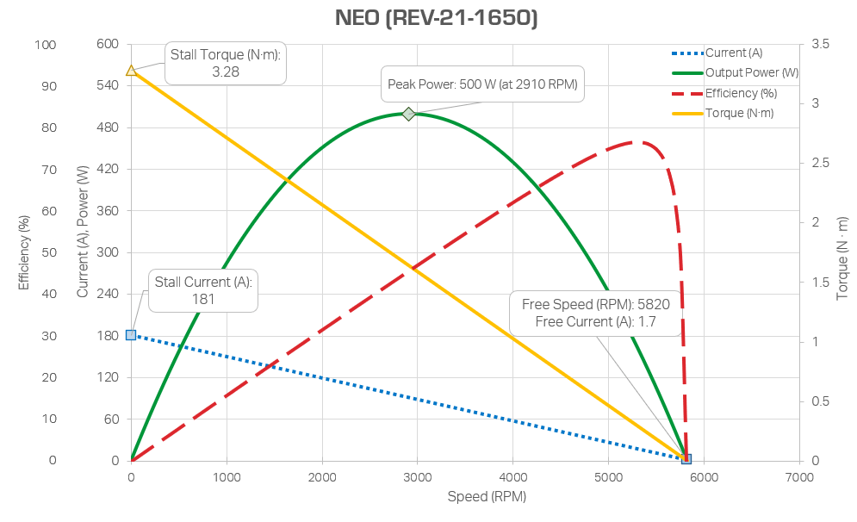
NEO Motor Curve

Slide 14
Questions & Open Discussion

